Slide 1
Chapter 15
How to use JavaScript and jQuery to enhance your web pages
Notes:
Session: Ghi số thứ tự session trong môn học
Session Name: ghi tên của session sẽ dạy
<number>

Slide 2
Objectives
Introduction to JavaScript and DOM scripting
The Email List Application in JavaScript
Introduction to jQuery
How to use jQuery in Email List application
Other application with jQuery
Notes:
Mô tả nội dung mà học viên phải đạt được khi kết thúc môn học này
<number>

Slide 3
Introduction to JavaScript and DOM scripting

Slide 4
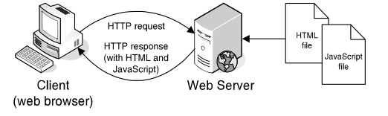
How JavaScript works
JavaScript is a scripting language that is run by the JavaScript engine of a browser. The work is done on the client, not the server
How JavaScript fits into the client/server architecture
Notes:
Mô tả nội dung chi tiết từng chuyên đề
<number>

Slide 5
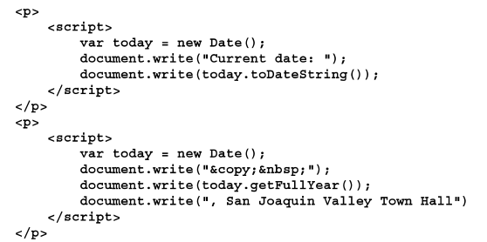
JavaScript example
JavaScript in HTML document

Slide 6
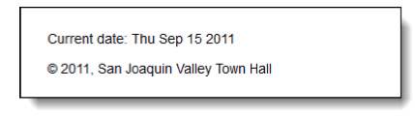
Result in web browser
The JavaScript in a web browser.
Notes:
Mô tả nội dung chi tiết từng chuyên đề
<number>

Slide 7
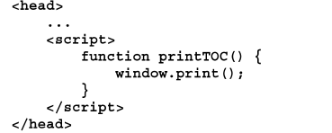
Three ways to include JavaScript in a web page
A script element in the head section that heads an external JavaScript
A script element in HTML
Embeds JavaScript in the body

Slide 8
The DOM (Document Object Model) works
The DOM (Document Object Model) is a hierarchical collection of nodes in the web browser’s memory that represents the current web page

Slide 9
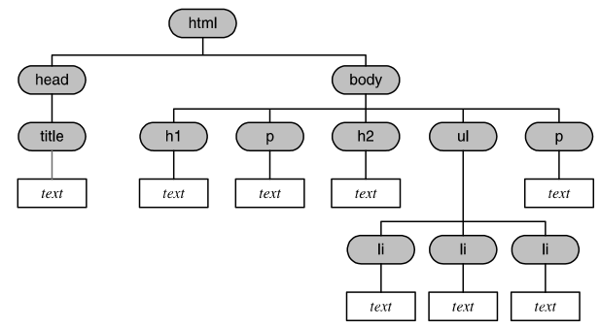
Example: The DOM for a web page

Slide 10
Methods and properties for DOM Scripting
Two methods of the document object
Three properties that can be used for scripting the DOM
Method | Description
getElementById( id ) | Gets the HTML element that has the id that’s passed to it and returns that element.
write( string ) | Writes the string
Property | Description
value | For an input element like a text box, gets or sets the value in the element.
firstChild | Return a Node object for the first child node of an element
nodeValue | For a Text, Comment, or Attribute node, gets or sets the text that’s stored in the node.

Slide 11
How DOM scripting works
DOM scripting is the process of manipulating the DOM by using JavaScript
An event is an action the user performs like clicking a mouse button. When the event occurs, JavaScript is used to process it. This code is called an event handler

Slide 12
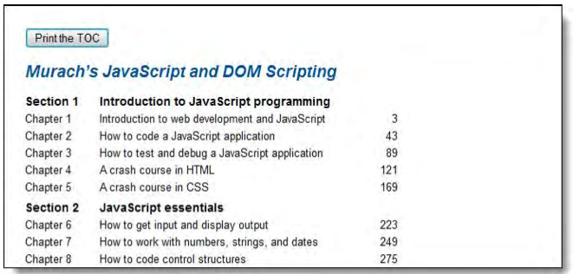
DOM Example
A web page that uses a JavaScript button for printing

Slide 13
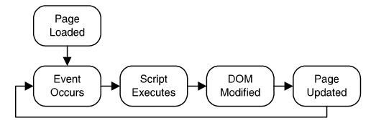
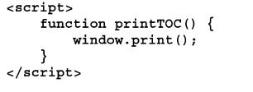
DOM code Example
The DOM event cycle
The JavaScript in the head section
The HTML code

Slide 14
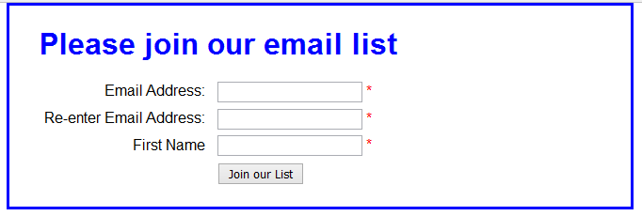
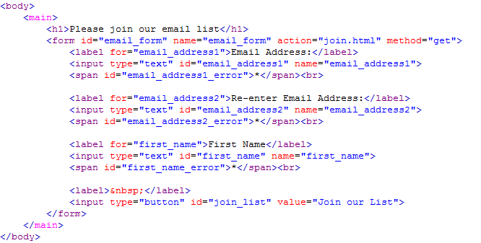
The Email List Application in JavaScripts (page 508)

Slide 15
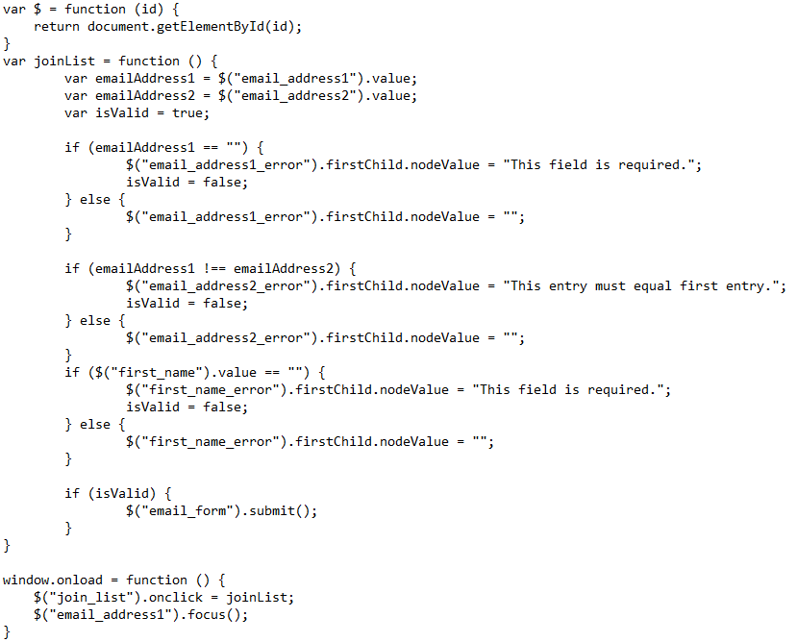
The Email List Application in JavaScripts (page 508)

Slide 16
Introduction to jQuery

Slide 17
What jQuery is and where to get it
jQuery is a free, open-source, JavaScript library that provides dozens of functions for common web features
JavaScript library that makes JavaScript programming easier
It provides widgets, interaction, effects, and themes that can be use to build features like carousels and slide shows
JavaScript library that provides higher-level function like advanced widgets that can be easily customized by using themes that override the themes component of jQuery
Notes:
Mô tả nội dung chi tiết từng chuyên đề
<number>

Slide 18
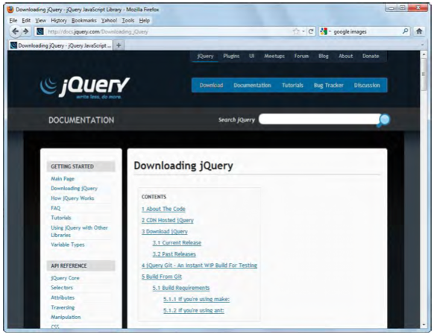
jQuery website
The jQuery web site at www.jQuery.com

Slide 19
jQuery libraries
The two jQuery libraries
jQuery (the core library)
jQuery UI (User Interface)
What jQuery offers
Dozens of functions that make it easier to add JavaScript features to your web pages
Functions that are tested for cross-browser compatibility

Slide 20
How to include jQuery and jQuery UI in your web pages
To use jQuery, you need to include 03 files to jQuery applications
The jQuery JavaScript file
The jQuery UI JavaScript file
The jQuery UI stylesheet
Two ways to include the jQuery files
Include the jQuery files from a Content Delivery Network (CDN) and
Include the jQuery files when they’re on web site
Notes:
Mô tả nội dung chi tiết từng chuyên đề
<number>

Slide 21
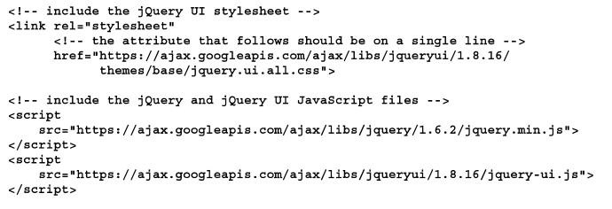
Include the jQuery files from a Content Delivery Network

Slide 22
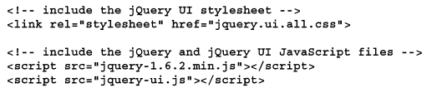
Include the jQuery files when they’re on web site

Slide 23
How to use jQuery
Code jQuery selectors
A type selector that selects all h1 elements
$(“h1”)
An id selector that selects the element with “accordion” as its id
$(“#accordion”)
A class selector that selects all elements in the “fadein” class
$(“.fadein”)

Slide 24
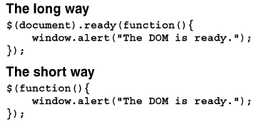
How to use jQuery
How to call jQuery methods
A call to the hide method of an h1 object
$(“h1”).hide(“slow”)
A call to the accordion method of the element with “accordion” as its id
$(#accordion).accordion()
Two ways to code a function that uses the jQuery ready method

Slide 25
How to use jQuery
How to call jQuery event methods
How to code ready event method
$(document).ready(function() {
alert(“The DOM is ready”);
});
How to use the click event method within the ready event method
$(document).ready(function() {
$(“h2”).click(fuction(){
alert(“This heading has been cliked”);
});
});

Slide 26
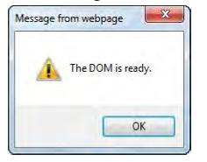
Result in web browser
The message box that’s displayed when the DOM is ready

Slide 27
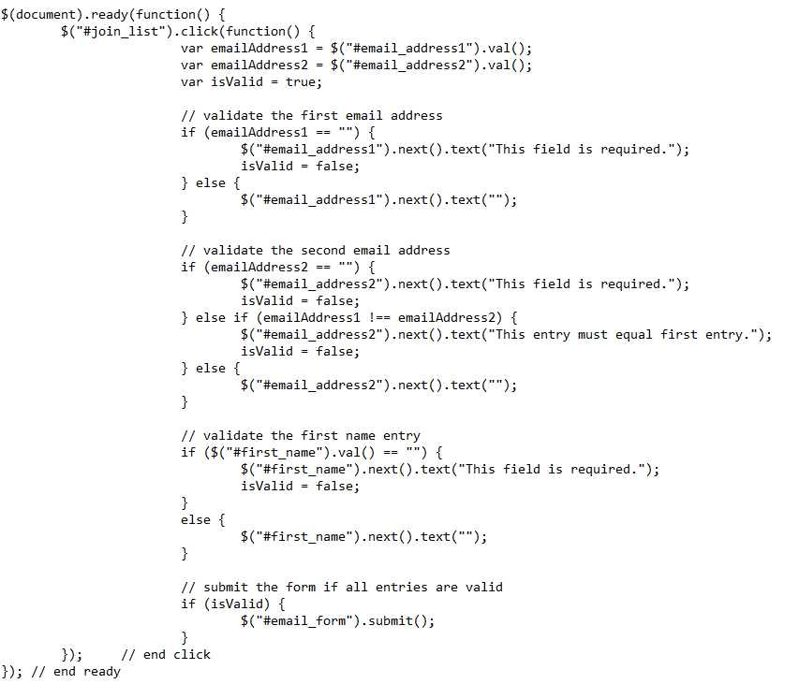
The Email List Application in jQuery (page 516)

Slide 28
How to use jQuery as non-programmer

Slide 29
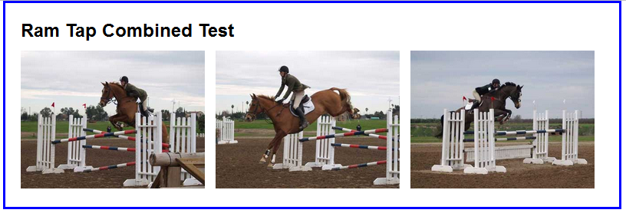
The Image Rollover application
An image rollover occurs when the user moves the mouse printer over one image and that image is temporarily replaced by another image.
A web page with the first image rolled over

Slide 30
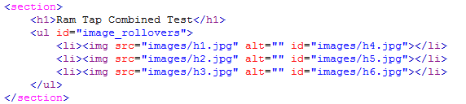
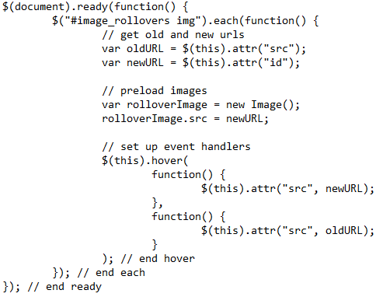
The Image Rollover application
HTML Code
JavaScript in the rollovers.js
Notes:
<number>

Slide 31
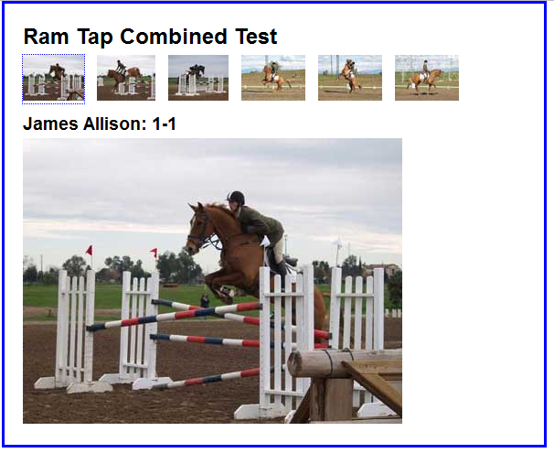
Image swap application
An image swap occurs when an event handler uses DOM scripting to replace one image with another.
A web page after the second thumbnail has been click

Slide 32
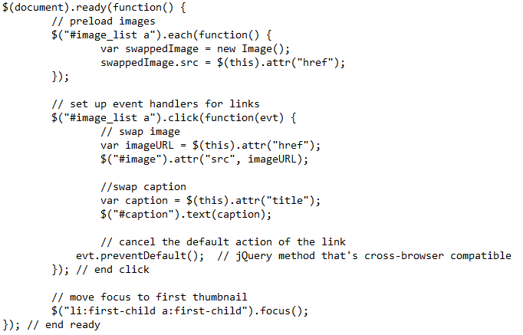
Image swap application – jQuery code

Slide 33
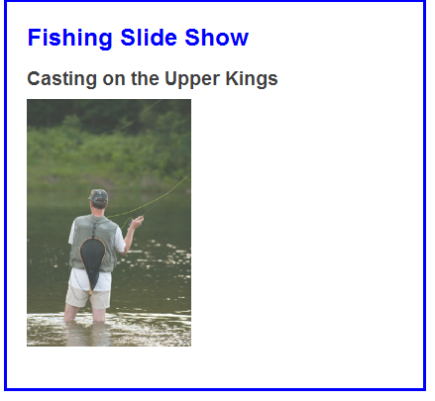
A slide shows application
Use jQuery to create a slide show. When the page loads, the first image is displayed. Then, every five seconds, the image fades out and the next image fades into its place.
A slide show that fades one image out and the next image in

Slide 34
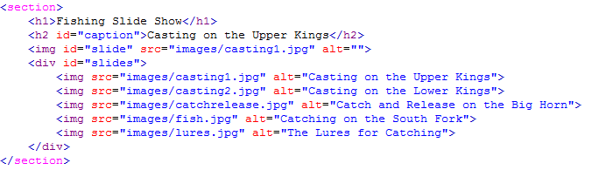
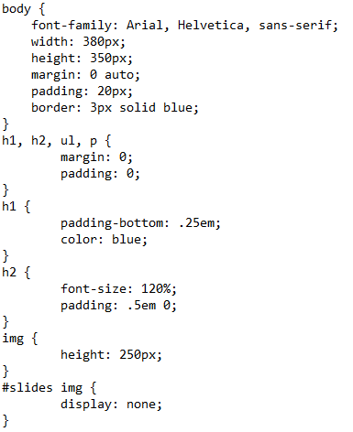
A slide shows application - code
The HTML for the slide show
The CSS code
Notes:
<number>

Slide 35
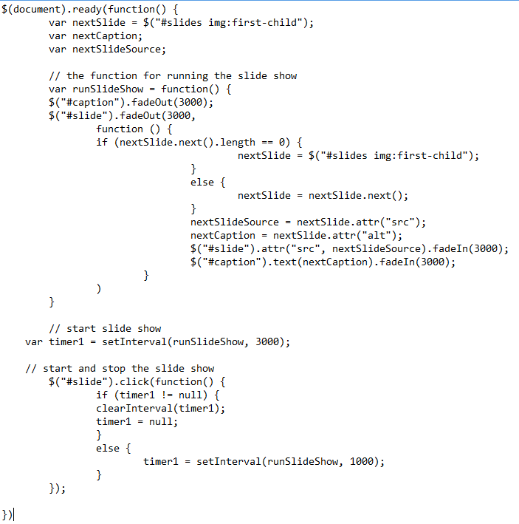
A slide shows application - code
jQuery code
Notes:
<number>

Slide 36
Summary
JavaScript is a scripting language that is run by the JavaScript engine of a browser.
The DOM (Document Object Model) is a hierarchical collection of nodes in the web browser’s memory that represents the current web page.
DOM script is the process of changing the DOM using JavaScript.
Notes:
Tóm tắt lại nội dung đã học
<number>

Slide 37
Summary
jQuery is a free, open-source, JavaScript library that provides dozens of functions for common web features. JavaScript library that makes JavaScript programming easier.
It provides widgets, interaction, effects, and themes that can be use to build features like carousels and slide shows.

Slide 38
Discussion
Notes:
Trả lời câu hỏi WHY?
<number>

